Slide 1
Genetic Manipulation of Chloroplast
Anandi R.

Slide 2



Chloroplast genetic system
A 50-290 kb double stranded circular molecule
A pair of 20-30 kb inverted repeat (IR) sequence

Slide 3


Chloroplast transformation
Expression level of foreign genes is higher than nuclear transformation
Multiple genes can be introduced as an operon

Slide 4


Stable transplastomic plants
Transformation of plastids has already been achieved for tobacco , Arabidopsis, soybean , cotton, lettuce, cauliflower and potato

Slide 5


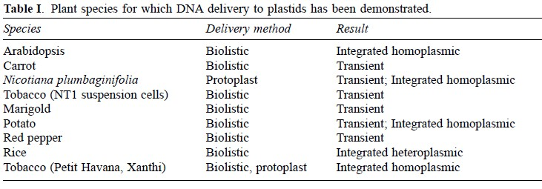
Plastid transformed plants

Slide 6

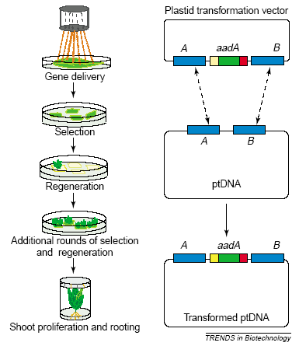
Basics of Chloroplast Transformation
Chloroplast Transgenic Production

Slide 7

Chloroplast transformation techniques
Biolistic delivery systems
Polyethylene glycol (PEG) treatment of protoplast
The technique has a lower success rate than biolistic bombardment
long selection times required after initial DNA delivery
Technically demanding and requires specialized tissue culture skills
Femtoinjection technique: injection of DNA material into chloroplasts using syringes with extremely narrow tips
Agrobacterium-mediated plastid transformation

Slide 8

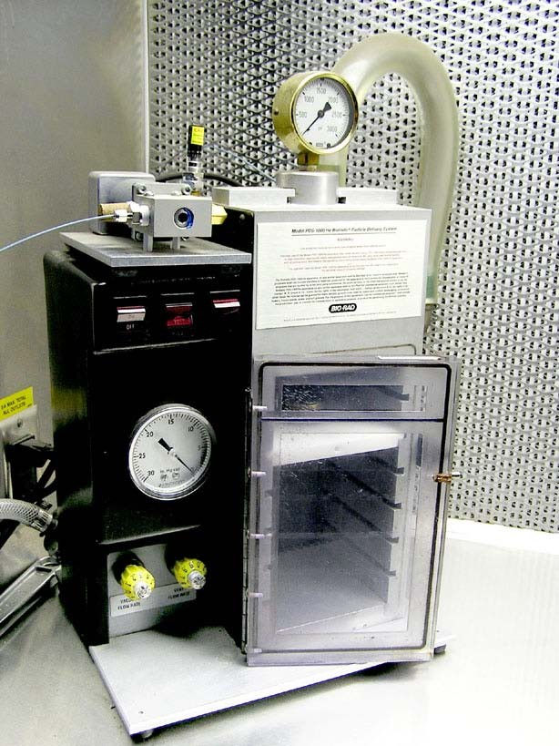
Particle Delivery System

Slide 9


Advantages and disadvantages of biolistic method
Relatively high efficiency
Technical simplicity

Slide 10

Advantages of injection technique
Cells survive the injection
Transformed cell can be spotted easily
Cellular context remains intact

Slide 11
https://www.youtube.com/watch?v=dX3jmX7qBlw

Slide 12
Thank You

